Slide 1
Lecture 3
Building and Using Actor Classes

Slide 2
Lecture Goals and Outcomes
The goals of this lecture are to
Show how to add components to a Blueprint
Introduce the Construction Script
Present various types of events
Demonstrate how to spawn, destroy, and reference Actor instances
Show how to do input mappings
By the end of this lecture you will be able to
Add various types of components to a Blueprint
Manage Actor instances
Create collision and mouse events
Create input events and map keys and axes

Slide 3
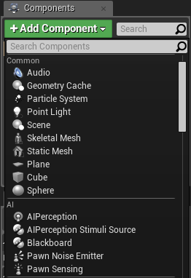
components
Components are ready-to-use classes that can be used inside Blueprints. Several features can be included in a Blueprint using only components.
To add components to a Blueprint, use the Components panel in the Blueprint Editor.
The image on the right shows the Components panel for a new Blueprint with some component options that are displayed when the Add Component button is pressed.

Slide 4
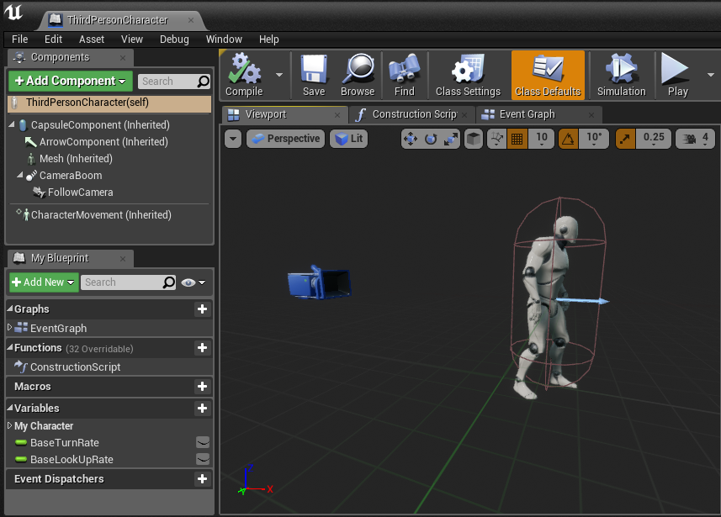
Components: viewport
The visual representation of the components can be seen in the Viewport.
The image on the right shows the components that are part of the ThirdPersonCharacter Blueprint from the Third Person template. The components that have “(Inherited)” next to the name were inherited from the Character class.
The CapsuleComponent is used for collision testing.
The Mesh component is the Skeletal Mesh that visually represents the character.
The FollowCamera component is the camera that will be used to view the game.
The CharacterMovement component contains various properties that are used to define the movement.

Slide 5
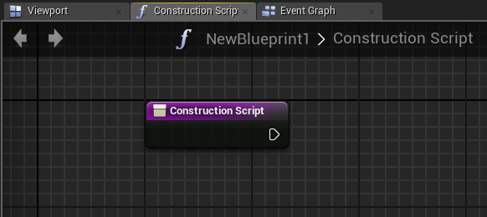
Construction Script
The Construction Script is a special function that all Actor Blueprints perform when the Blueprint is first added to the Level, when there is a change to its properties, or when the class is spawned at runtime. The Construction Script has a separate graph where the actions to be performed can be placed.
It is important to note that the Construction Script won’t run on placed Actors when the game starts.

Slide 6
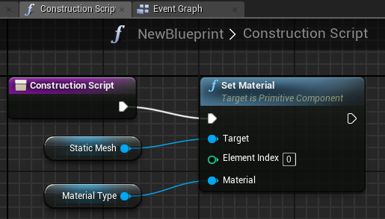
Construction Script: example
The Construction Script seen on the right uses the Set Material function to define a Static Mesh component’s Material type according to the Material selected in the editable variable Material Type.
Whenever the Material Type variable is modified, the Construction Script runs again, updating the object with the new Material.

Slide 7
Events

Slide 8
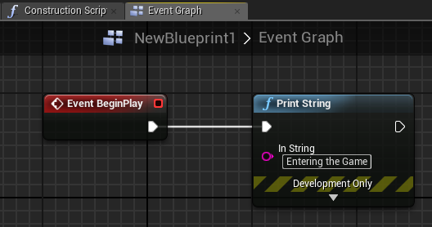
Begin play event
Events allow communication between Unreal Engine and Actors. A common example is the BeginPlay event.
The BeginPlay event is triggered when the game starts for an Actor. If the Actor is spawned in the middle of the game, then this event is triggered immediately.

Slide 9
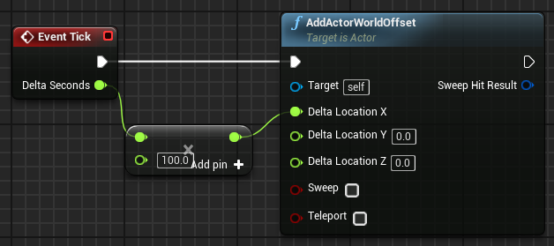
tick event
There is an event named “Tick” that is called every frame of the game. For example, in a game that is running at 60 frames per second, the Tick event is called 60 times in a second.
The Tick event has a parameter known as Delta Seconds, which contains the amount of time that has elapsed since the last frame.
In the Tick event illustrated on the right, an Actor moves along the X axis at the speed of 100 centimeters per second.
Use the Tick event only when necessary, as it can affect performance.

Slide 10
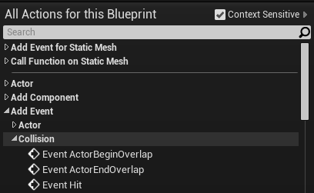
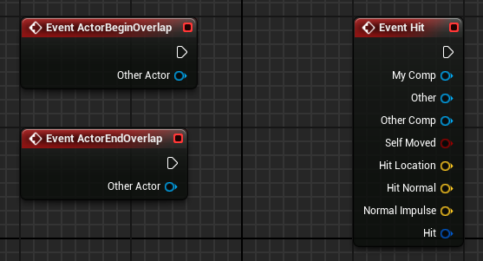
Collision events
Collision events are triggered when two Actors collide or overlap.
Event ActorBeginOverlap will execute when two Actors start overlapping and the Generate Overlap Events property of both Actors is set to “true”.
Event ActorEndOverlap will execute when two Actors stop overlapping.
Event Hit will execute if the Simulation Generates Hit Events property of one of the Actors in the collision is set to “true”.

Slide 11
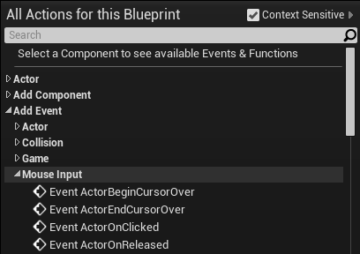
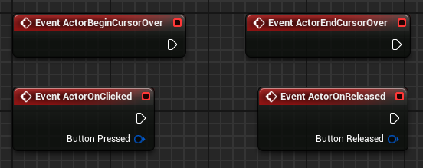
Mouse Interaction
There are some events related to mouse interaction with an Actor.
Event ActorBeginCursorOver is called when the mouse cursor moves over the Actor.
Event ActorEndCursorOver is called when the mouse cursor moves off the Actor.
Event ActorOnClicked is called when the mouse clicks on the Actor.
Event ActorOnReleased is called when the mouse button is released and the mouse cursor is still over the Actor.

Slide 12
Actor Instances

Slide 13
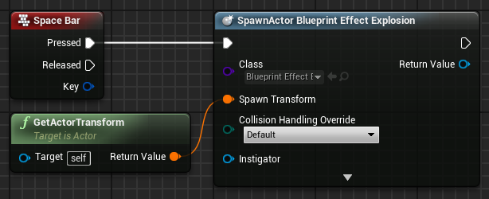
Spawning actors
Spawn Actor from Class is a function that creates an Actor instance using the class and transform specified.
The Collision Handling Override input defines how to handle the collision at the time of creation. The output parameter Return Value is a reference to the newly created instance.
In the example on the right, when the space bar is pressed, an instance of the Blueprint Effect Explosion class is created at the same location (transform) of the current Blueprint.

Slide 14
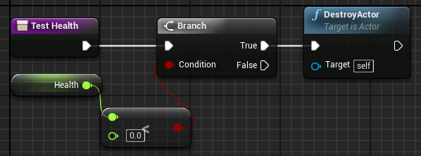
Destroying actors
The DestroyActor function removes an Actor instance from the Level at runtime. The instance to be removed must be specified in the Target parameter.
The image on the right shows a function named “Test Health” that will check if the value of the Health variable is less than zero. If “true”, the current instance of this Blueprint, which is represented by “self”, will be destroyed.

Slide 15
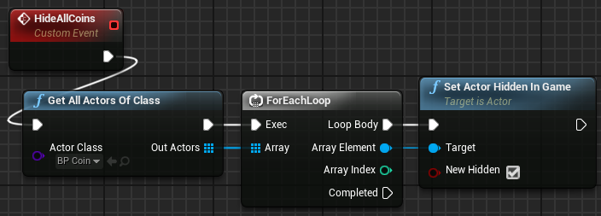
Get all actors of class
Get All Actors Of Class is a function that gets the references of all the Actors in the current Level who belong to a specified class.
The Actor Class parameter specifies the class that will be used in the search.
The Out Actors output parameter is an array containing references to the Actor instances of the specified class found in the Level.
In the image on the right, Get All Actors Of Class returns an array of BP_Coin Actors, then uses a ForEachLoop node to set the New Hidden property to “true” in the Set Actor Hidden In Game function for each Actor in the array.
This can be a costly operation. Do not use it in the Tick event.

Slide 16
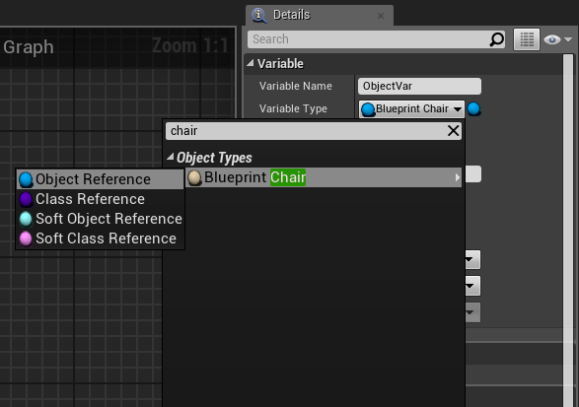
Referencing actors
In a Blueprint, it is possible to create a variable that references an Object / Actor.
The example on the right shows the creation of a variable that references an instance of the Blueprint_Chair class. An Object Reference points to an Actor that is in the Level.
When created, the variable is empty. A way to set an instance to this variable is to check the Instance Editable property, add the Blueprint to the Level, and in the Details panel select an Actor that is in the Level.
Another way is to use the return value of the Spawn Actor from Class function.

Slide 17
Player Input

Slide 18
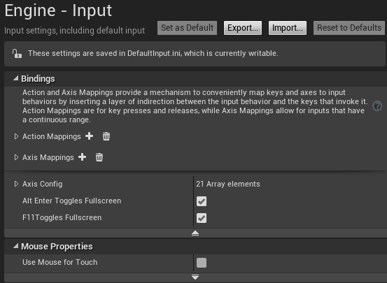
Input Mappings
It is possible to create new input events that represent actions that make sense in the game.
For example, instead of creating an input event for the left mouse button that will trigger a gun, it is better to create an action event called “Fire” and map all keys and buttons that can trigger this event.
To access the input mappings, in the Level Editor menu, go to Edit > Project Settings... and in the Engine category select the Input option.

Slide 19
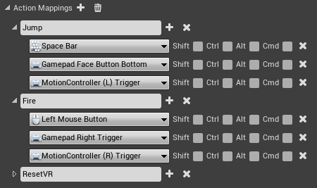
Action mappings
Action mappings are for key and button presses and releases.
The image on the right shows an example of action mappings from the First Person template.
In this example, an action named “Jump” has been created that can be triggered by the space bar, the bottom face button of a gamepad, or the left trigger of a motion controller.

Slide 20
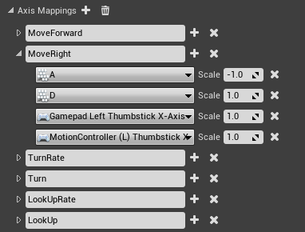
axis mappings
Axis mappings allow for inputs that have a continuous range, such as the movement of a mouse or the analog sticks of a gamepad.
Keys and buttons can also be used in the axis mapping. In the example on the right, the MoveRight action is mapped to the “D” key, with the value of the Scale property set to “1.0”, and to the “A” key, with the value set to “–1.0”, which represents the reverse direction.

Slide 21
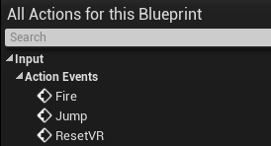
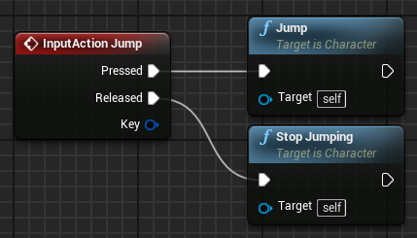
input action events
All action mappings are available in the Blueprint Editor under Input > Action Events in the context menu.
An InputAction event is generated when the keys or buttons associated with it are pressed or released.
The bottom image on the right shows an example of an InputAction event.

Slide 22
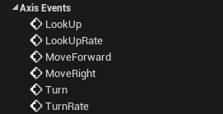
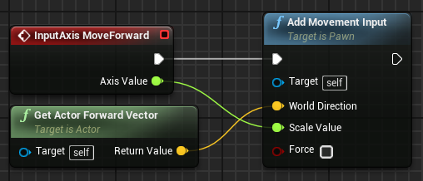
input axis events
All axis mappings are available in the Blueprint Editor under Input > Axis Events in the context menu.
An InputAxis event continuously reports the current value of the axis.
The bottom image on the right shows an example of an InputAxis event.

Slide 23
SUMMARY
This lecture presented components and the Construction Script and showed how to add various types of events to a Blueprint.
It also explained how to manage Actor instances and how to do input mappings.

